Slide 1
Access Control
How to control access to resources?
By Matthew Tancreti
For COM S 352
Iowa State University

Slide 2
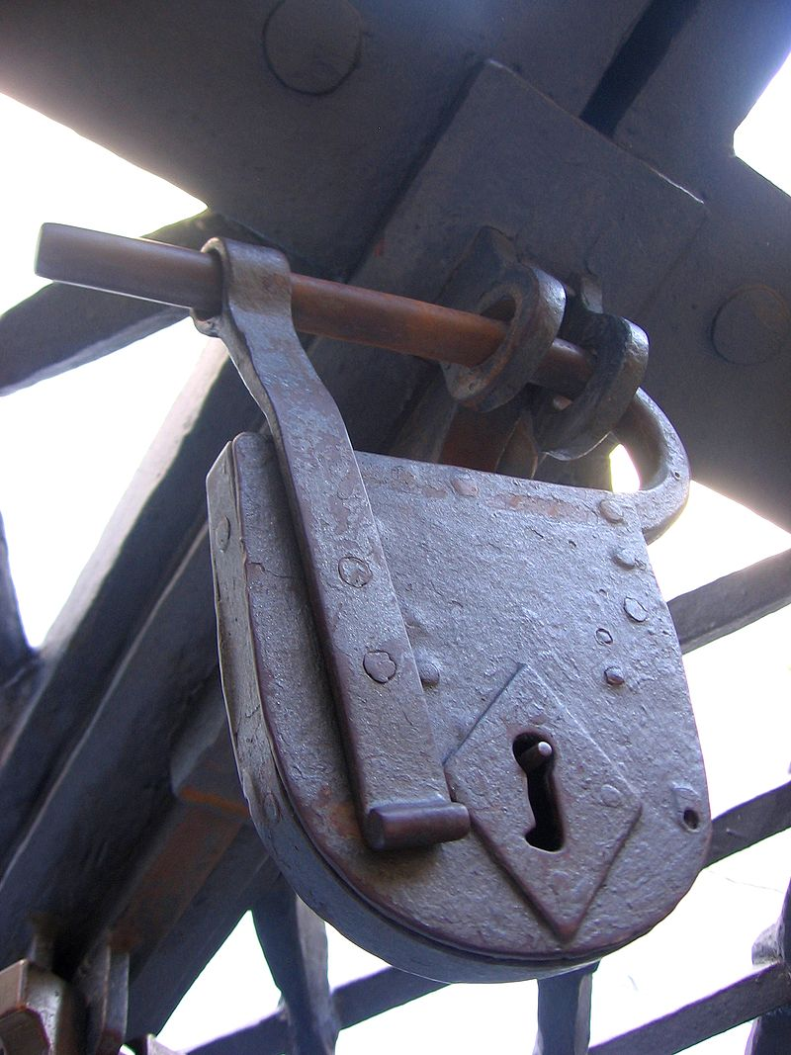
Access Control
Systems have resources that need protected from unauthorized access
Need ability to grant/revoke and search access permission
Reading Security in Computing by Charles P. Pfleeger, Shari Lawrence Pfleeger, and Jonathan Margulies, 2007.
How to protect access to resources?
Padlock [source]

Slide 3
Access Control
Access control is regulating what actions subjects can perform on general objects (e.g., files, tables, hardware, network connections, etc.)
Objects are resources on which an action can be performed: files, tables, programs, memory objects, hardware devices, strings, data files, network connection processors, etc.
Subjects human users or agents (e.g., processes) that represent users from which objects are protected
Access mode are controllable actions of subjects on objects, for example: read, write, modify, delete, execute, create, etc.

Slide 4
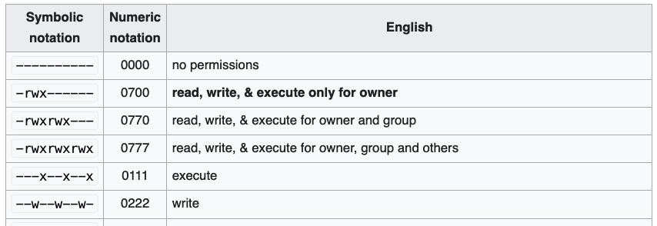
Traditional Unix File System Permissions
Each file/directory has an owning user and group
Read, write and execute permissions are specified for the user, group and all users
Has many limitations, for example, cannot put file into multiple groups

Slide 5
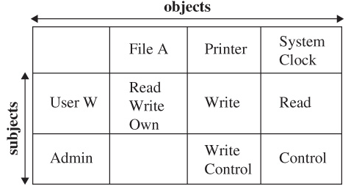
Access Control Matrix
An alternative is the access control matrix which describes the access modes granted to subjects on objects
access modes

Slide 6
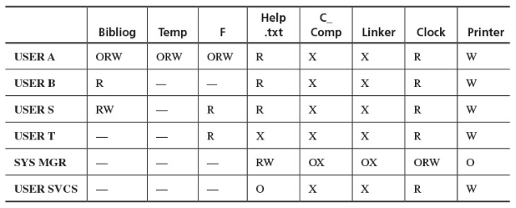
Access Control Matrix Example
Matrix may be sparse (many empty cells)

Slide 7
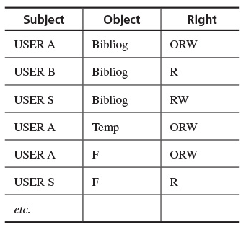
List of Access Control Triples
A less sparse representation of the access control matrix is a list of access control triples
Slow search time, so not often used

Slide 8
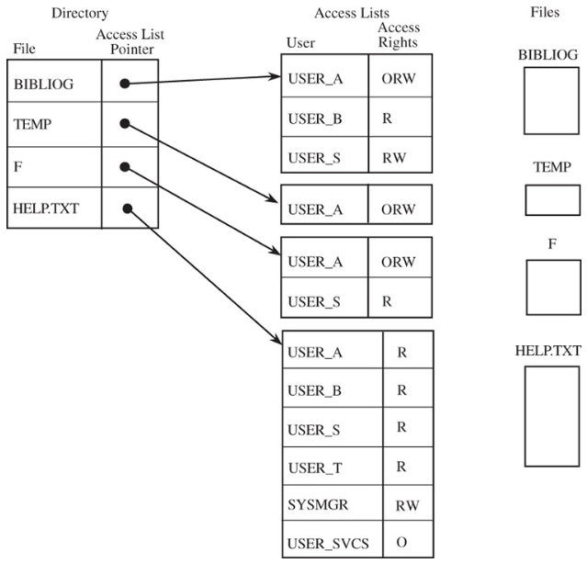
Access Control List
An alternative to the access control matrix is the access control list
Each column (object) of the access control matrix is stored in a separate list

Slide 9
Access Control Matrix vs List
Access control matrix
Pro: fast lookup for either subject or object
Con: matrix is typically sparse, wasted memory
Access Control List
Pro: Memory efficient
Con: does not have fast lookup for both subject and object
Example: What algorithm could be used to find all files a user has read access to? Consider both access control matrix and list, which is faster?

Slide 10
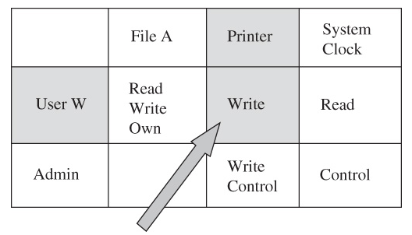
Capability
A capability is a tuple of (subject, object, access mode), for example: (User W, Printer, Write)
Capabilities are like tickets some OSes uses to keep track of what processes are allowed to do

